Slide 1
Biology 101: Ecosytems, Conservation & Ecology Wrap-up
SECTION 2
DR. ANAND
MAY 03, 2017

Slide 2
Matter Cycles

Slide 3
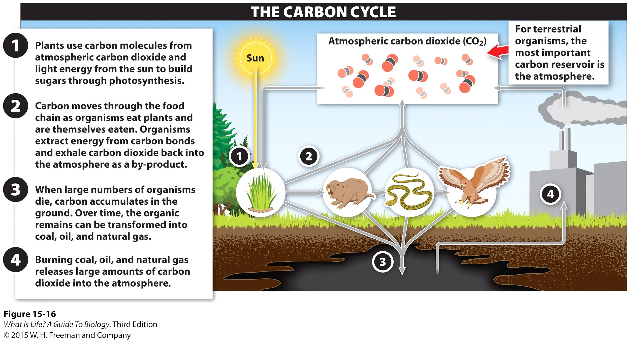
Carbon cycle
Carbon
sequestration

Slide 4
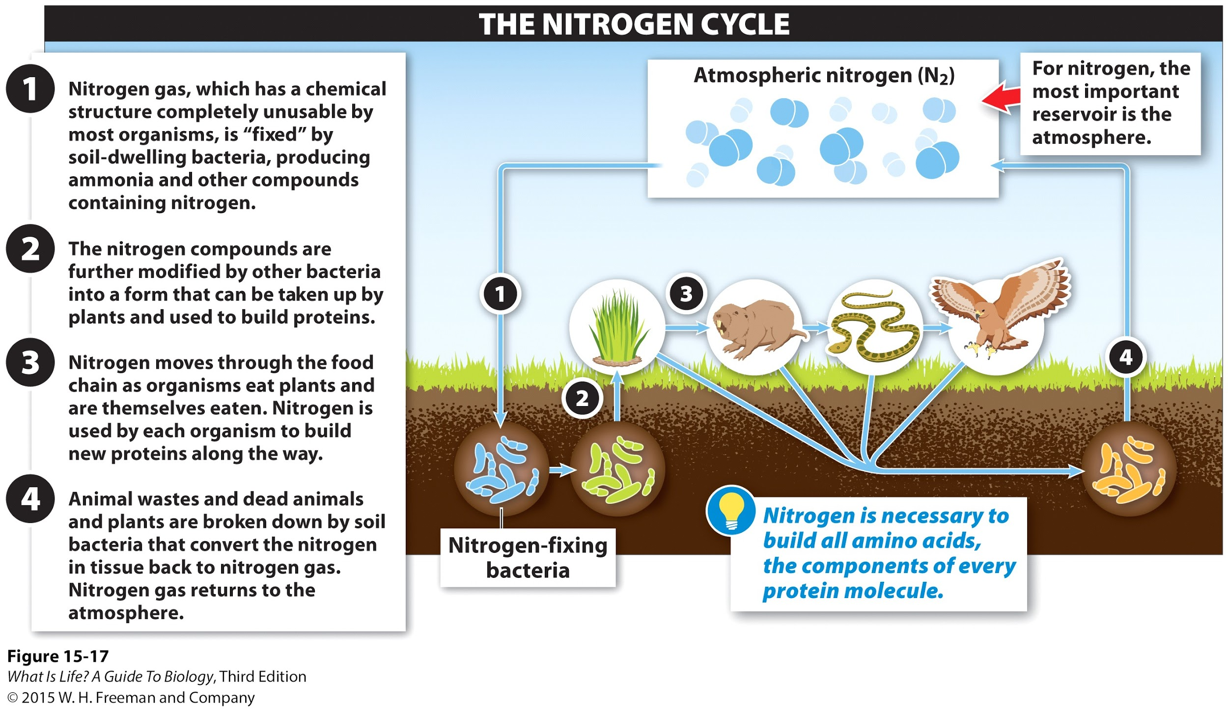
Nitrogen Cycle

Slide 5
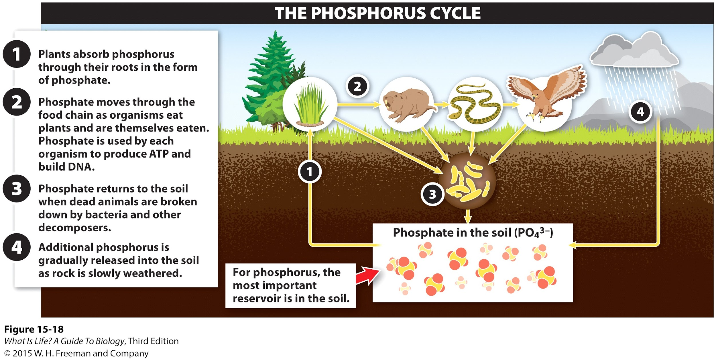
Phosphorus Cycle

Slide 6
Matter Cycles Summary
 | Why important? | Primary Reservoir | Special Characteristic
Carbon cycle | EVERY organic molecule | atmosphere | Decomposing organic matter often gets incorporated into soil
Nitrogen cycle | EVERY amino acid | atmosphere | Bacteria are critical links between atmosphere & food web
Phosphorus cycle | Nucleic acid backbone | soil | Weathering is critical component of cycle

Slide 7
General points about matter cycles
Each cycle is unique, but common features
Reservoir → where the pool of elements exists in the environment.
Two options: atmosphere or soil
Plants are the entry point to the food web
Matter cycles through the food web until organisms die
Decomposers break down organic waste
The nitrogen cycle is unique: special bacteria serve as connections between reservoir & food web
For each cycle, should know why it is important:
Carbon found in every organic molecule
Nitrogen found in every amino acid → proteins
Phosphorus found in every nucleic acid → DNA & RNA

Slide 8
Conservation

Slide 9

What to conserve?
Conservation is focused on preserving biodiversity
Different aspects of biodiversity
Ecosystem diversity
Species diversity → Diversity within a community
Genetic diversity → Diversity within a population
Often need to evaluate trade-offs: can’t preserve all three aspects

Slide 10
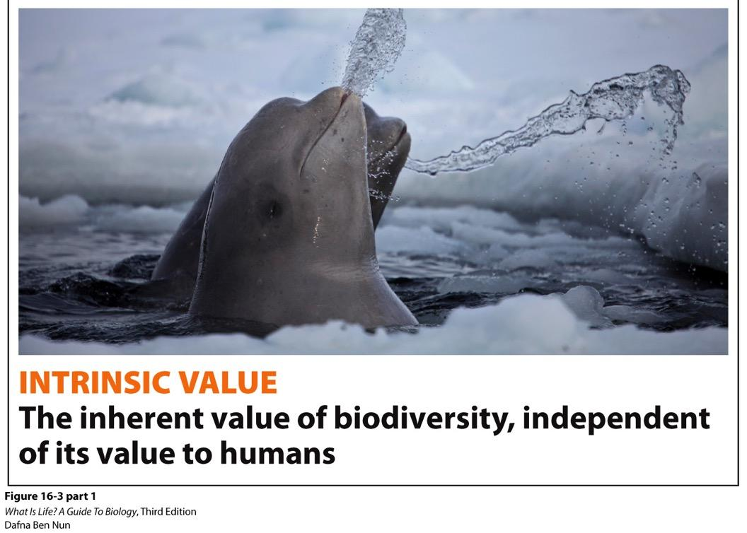
Intrinsic Value

Slide 11
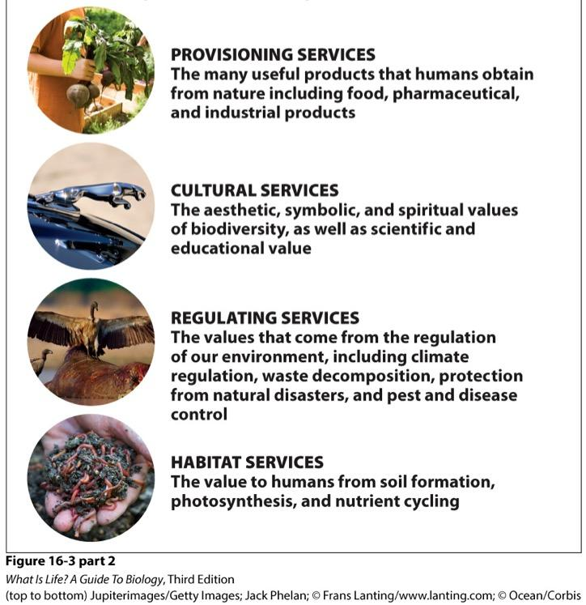
Extrinsic Value
Direct benefits of biodiversity to humans
Sometimes called “ecosystem services”
Scientists & economists work together to try to assign a monetary value to these
e.g., how valuable are wetland areas in providing coastal protections for flooding?

Slide 12
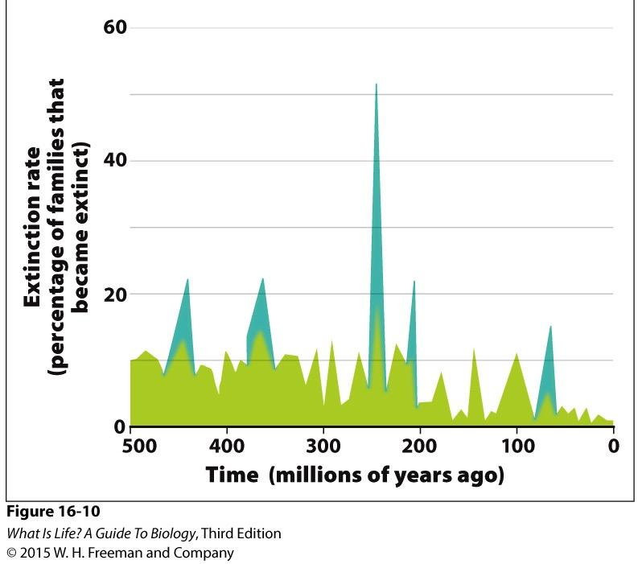
Extinction
Extinction = complete elimination of a species
Mass extinction
Large number of species or groups of species eliminated in a geologically short period of time
Background extinction
Fairly continual low rate of extinction due to changing environmental conditions

Slide 13
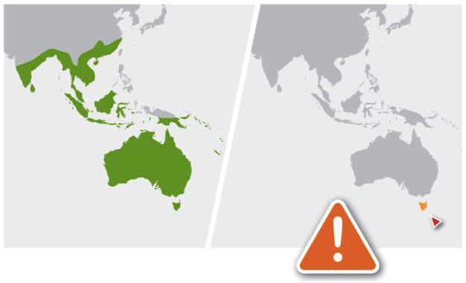
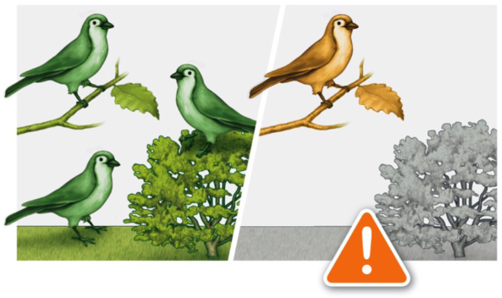
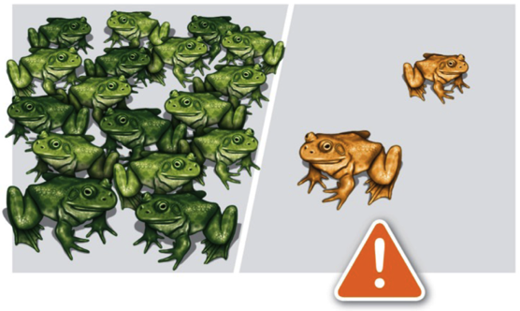
Background Extinction
Factors that increase extinction risk:
Restricted geographic range
Narrow habitat requirements
Small population size

Slide 14
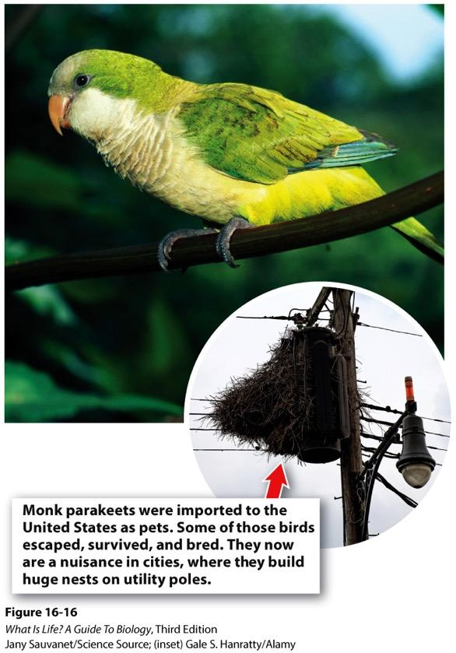
Invasive Species
Non-native species introduced accidentally or intentionally
Multiple factors influencing effects of invasive species on native community
Lack of predators
More efficient reproduction
Competitive advantages
Can displace native species that occupy the same niche
e.g., pythons in Florida Everglades displacing alligators

Slide 15
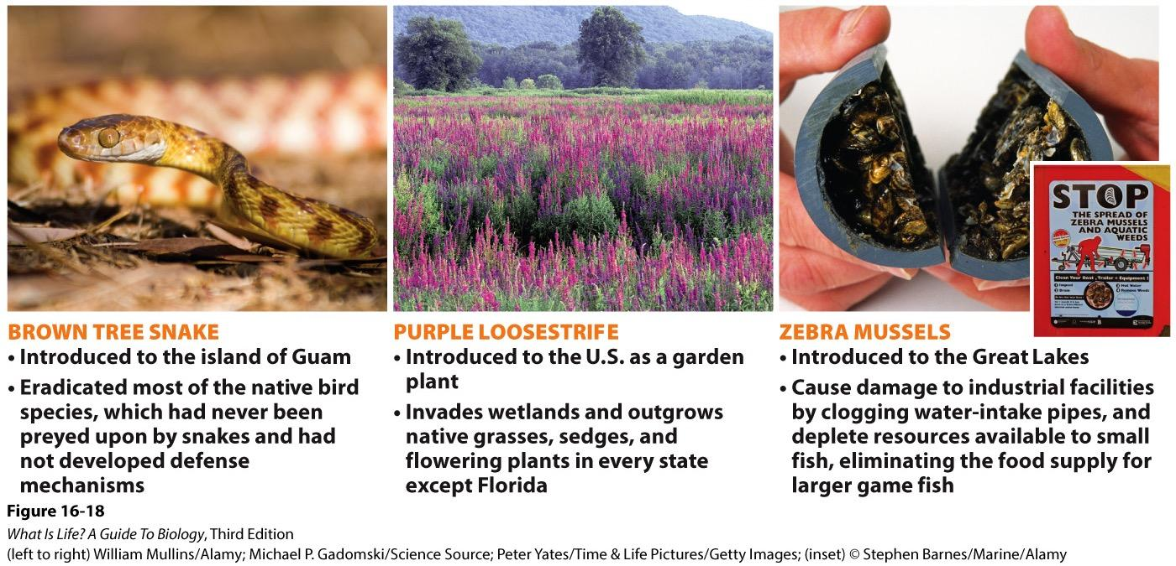
Invasive Species: Examples
Problem in Southern California too!

Slide 16
Population Growth Scenario
Density-dependent biotic
You are looking over some data & observations collected over the course of a year for a population of bears in Alaska. These data indicate that the total number of bears in this population at the start of the study was 50. The following events that affected the population were observed:
The salmon run was especially large this year, with nearly double the average number of salmon passing through the study area.
An early blizzard caught many bears out of their dens before they had settled in to hibernate.
Growing conditions in the spring were especially well-suited to the shrubs that produce berries that are a favorite food source of these bears.
Heavy spring rains led to a landslide that wiped out about 1/3 of the caves usually used for hibernation. The rains were late enough in the season that no hibernating bears were in the caves at the time.
A population survey conducted over the course of the year found that 10 cubs were born during the year, but only 7 survived to maturity. Three bears died of old age. The landslide prompted 4 bears to move their territories to a nearby river outside this population.
Density-independent abiotic
Density-dependent abiotic
Birth (10) + Immigration (0) = Death (3 + 3 = 6) + Emigration (4)

